Slide 1
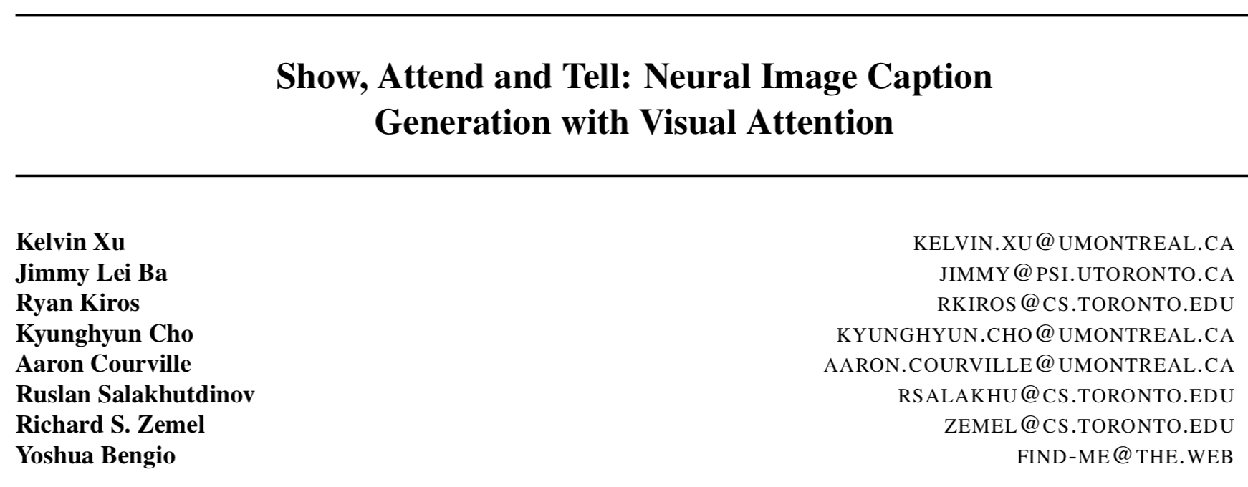
Presenter: Wen Wei Kang

Slide 2
Introduction
Model detail
Attention mechanism
Evaluation

Slide 3
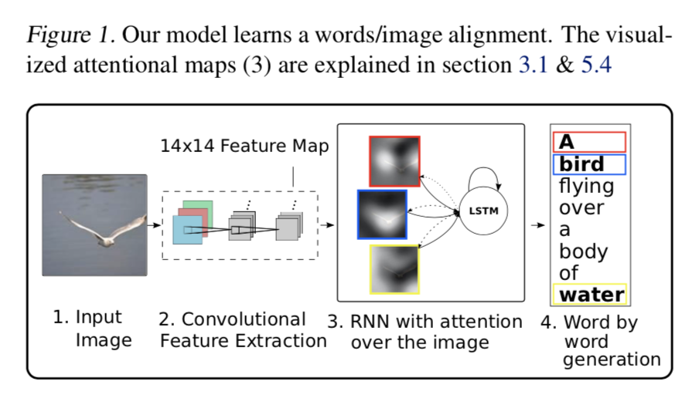
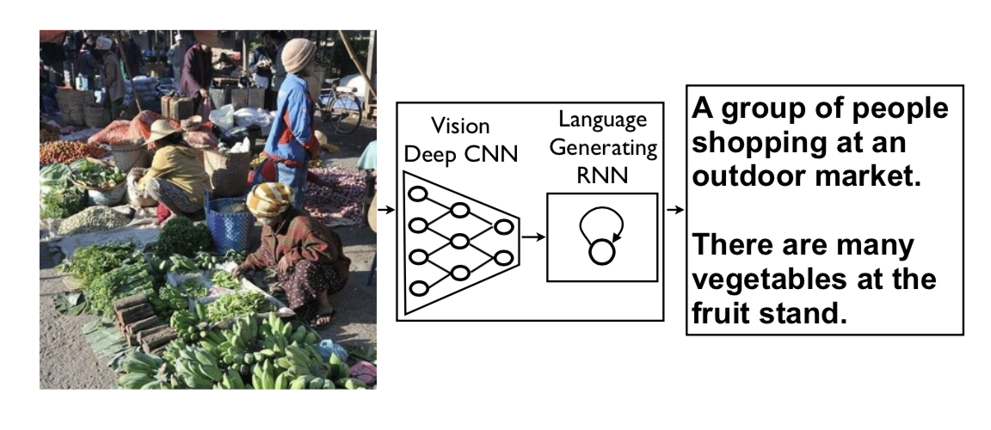
Introduction
Show and tell: NIC
(Vinyals et al.)
Show, Atten and Tell
(Xu et al.)
Feature map

Slide 4
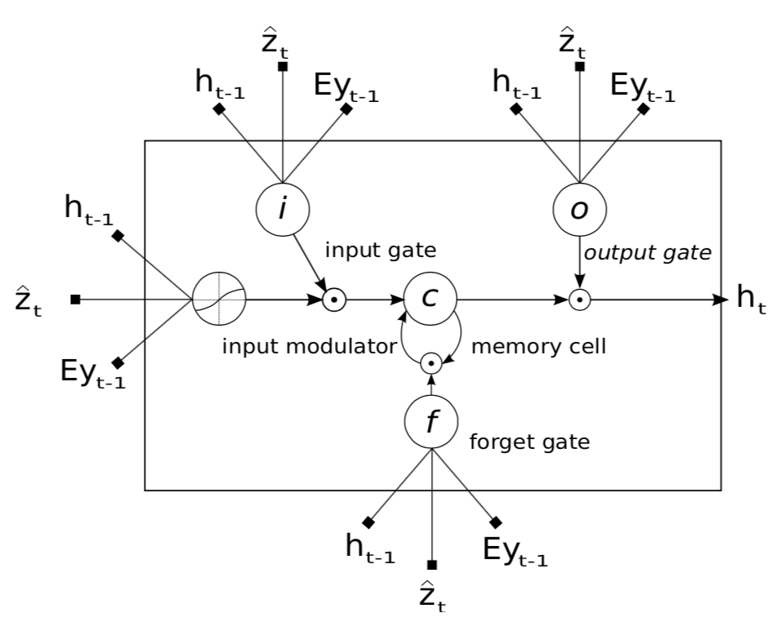

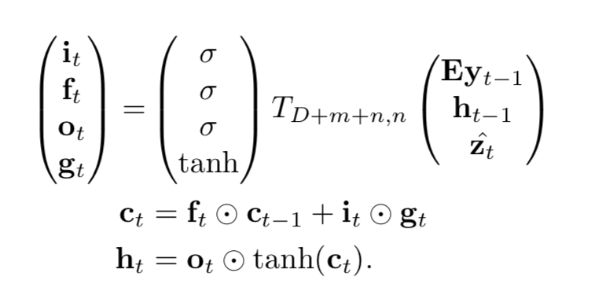
Model detail(1/2)
VGG-19
Feature map
$$14×14×512$$
Context vector

Slide 5
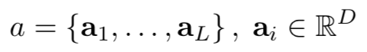
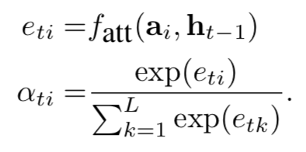
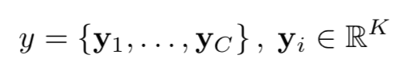
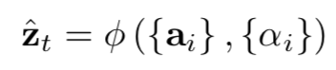
Model detail(2/2)
Feature map
reshape
$$14×14×512$$
$$196×512$$
$$L=196,D=512$$
Multilayer perceptron
$$C:captionlength$$
$$K:vocabularysize$$

Slide 6
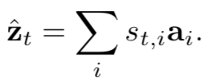
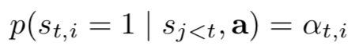
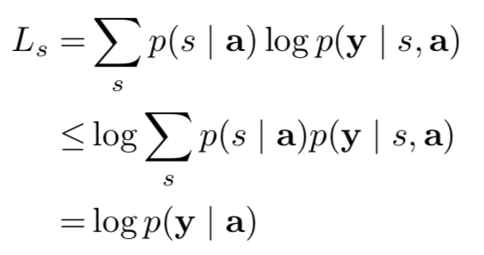
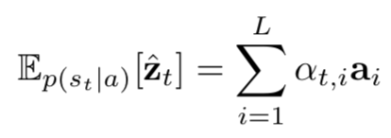
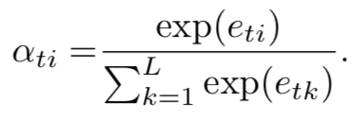
Attention mechanism
Stochastic Hard Attention
Multiple Binomial Distribution
$$s_{t,i}isaone-hotvariable$$
Deterministic Soft Attention
Double Stochastic Attention
$$\underset{i}{∑}α_{ti}=1$$
$$ϕ(\{a_{i}\},\{α_{i}\})=β\overset{i}{\underset{L}{∑}}α_{i}a_{i}$$
$$\underset{t}{∑}α_{ti}≈1$$
$$β_{t}=σ(f_{β}(h_{t-1}))$$

Slide 7
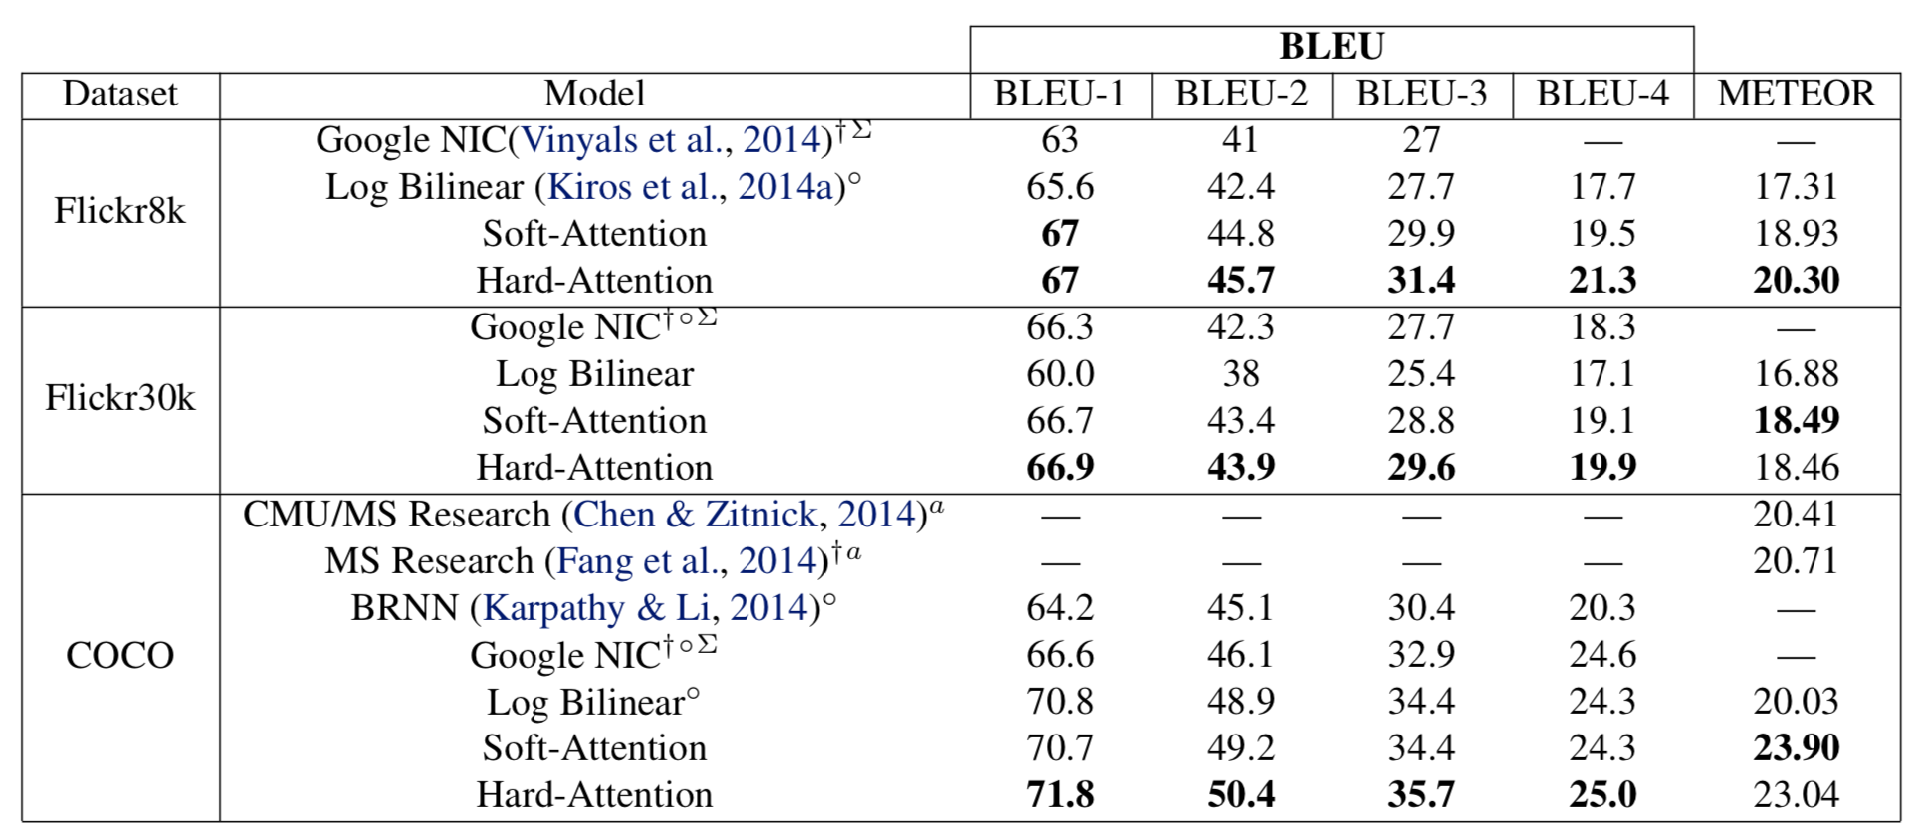
Evaluation(1/3)
$$†:indicatesadifferentsplit$$
$$∑:inicatesanensemble$$
$$a:inicatesusingAlexNet$$

Slide 8
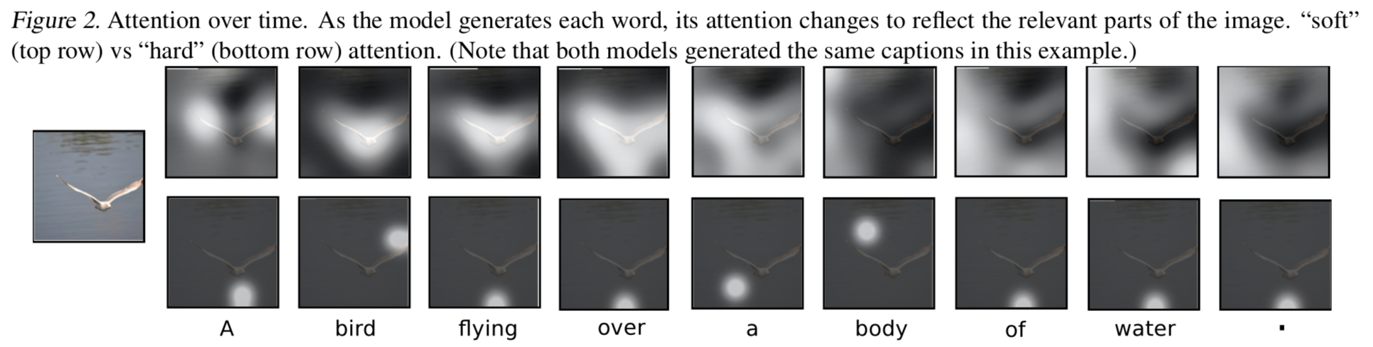
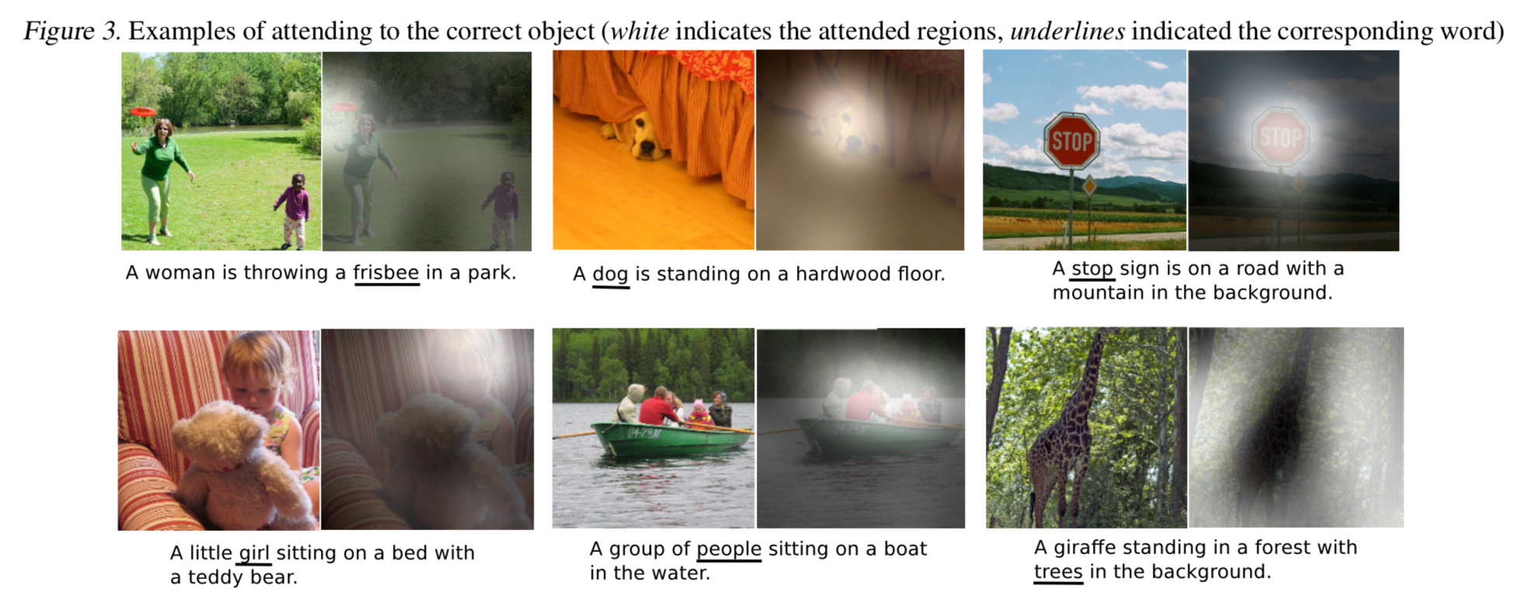
Evaluation(2/3)

Slide 9
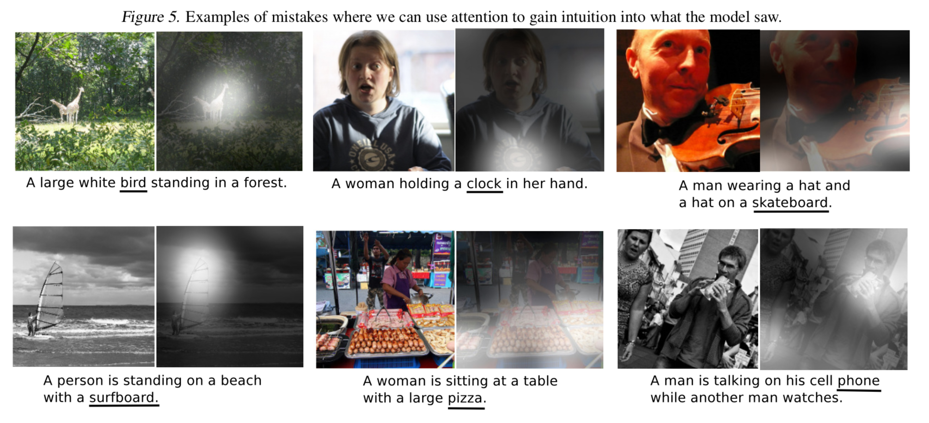
Evaluation(3/3)

